Slide 1


Jurisdictional alternatives

Slide 2





Cindy Brown, Director of Special Situs Trusts
Mechanics Bank, Moderator
ALASKA Matthew Blattmachr, President & CEO
& NEVADA: Peak Trust Company
DELAWARE: Matthew D’Emilio, Managing Member
McCollom D’Emilio Smith Uebler LLC
FLORIDA: Mark Parthemer, Chief Wealth Strategist & FL Regional Director
Glenmede
TENNESSEE: Eddy R. Smith
Kennerly Montgomery & Finley P.C.

Slide 3

Trustor request
Joe created a trust for the benefit of his children and grandchildren in 1995. It was established as a grantor trust and funded with marketable securities. Over the years, Joe has born the burden of the income tax on the trust assets. However, Joe is requesting assistance this year in the form of income tax reimbursement from the trust. The trustee is concerned about the ramifications of permitting the tax reimbursement.
What advice would you give to a trustee in your jurisdiction?
What does your state offer to limit the trustee’s liability should it choose to make the disbursement?

Slide 4
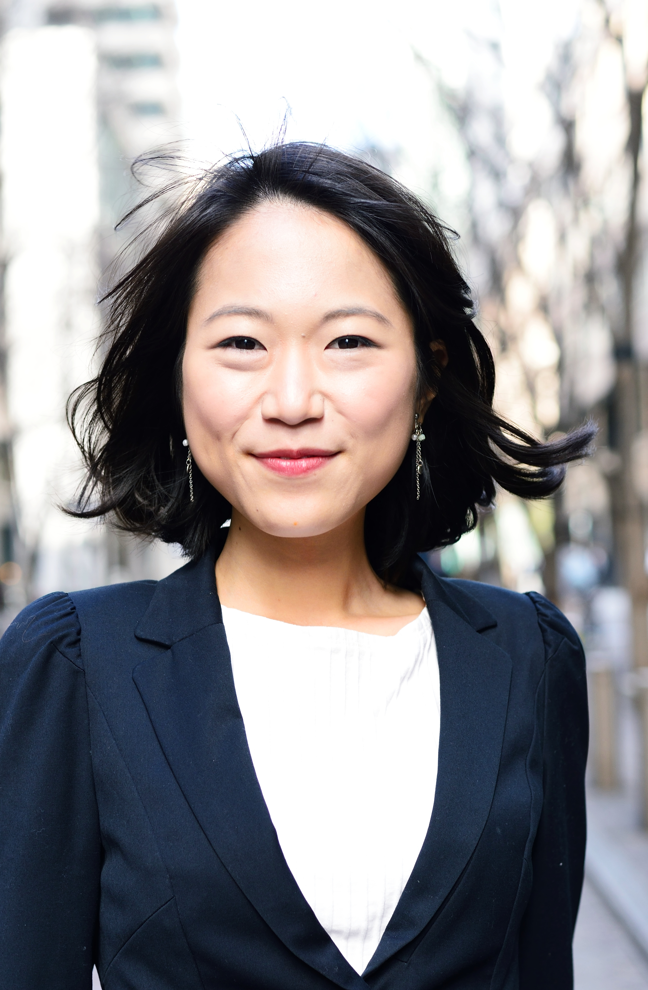
Investment delegation
Parent Trust Company is administering a trust created by the Smith Family. The trust includes language regarding a preference for ESG investing along with a policy statement outlining the family’s social platform. Parent Trust Company is not comfortable with ESG investing, feeling that they do not have sufficient experience. Parent Trust Company decides to delegate investment authority to Doing Things Right Investments; an investment firm focused on ESG investing and in particular socially driven investing.
What should the trust company consider when delegating investment authority?
What can the trust company do to mitigate liability when delegating authority to Doing Things Right Investments?

Slide 5
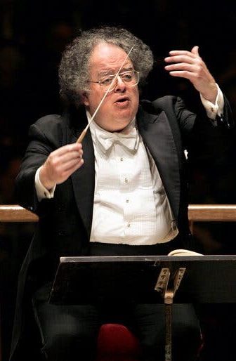
Directed trusts
Delaware resident Traci needs a corporate trustee to be the decisionmaker for Traci’s estate beneficiaries (“they would blow the money before my body reached room temperature”) but wants Territorial Investment Company to continue investing the assets (which, helpfully, Territorial is willing to do).
How could trusts in your jurisdiction be used to meet Traci’s goals?
What liability exposure would the trust company have for the actions of Territorial Investment Company?
This Photo by Unknown Author is licensed under CC BY-SA-NC

Slide 6


Community property and tenancy by the entireties trusts
Alex and Jordan are a married couple in Illinois who recently retired and plan to move to a warmer climate. They own a diversified portfolio—marketable securities, real estate, and an interest in a family business. Their financial advisor suggests retitling assets to optimize both creditor protection and potential tax savings.
Jordan reads that some states recognize the form of tenancy by the entireties (TBE) that offers full protection against the creditors of one spouse. Meanwhile, Alex hears about statutory community property trusts (CPTs), authorized in a few separate property states, that can provide a full step-up in basis for both halves of the property at the first spouse’s death.
Now they’re wondering:
Should they use TBE for protection or form a community property trust for the tax step-up?
Can they have both?
What happens if one spouse dies?

Slide 7

Pre-mortem validation & No-Contest clauses
Due to her declining health, Sally moved in with Anne, one of her three children. Appreciative of her assistance, Sally wants to leave the majority of her wealth to Anne but is concerned that her other children will contest her plan.
Is there any trust planning that Sally can do in your jurisdiction to mitigate post-death litigation?

Slide 8

Trust modification
Sam is the settlor of a 1980 irrevocable dynasty trust. He would like to modernize the trust by adding directed trust language and appointing an investment advisor to manage the trust assets. He is reaching out to you to determine what might be involved in modifying the trust. He would prefer that one of his children not be involved as they suffer from mental illness and would be overwhelmed to know that the family has money.
Is there a way to modify the trust in your jurisdiction to affect the changes needed?
Can the change be made without notifying the beneficiaries?

Slide 9
Thank you

